Slide 1
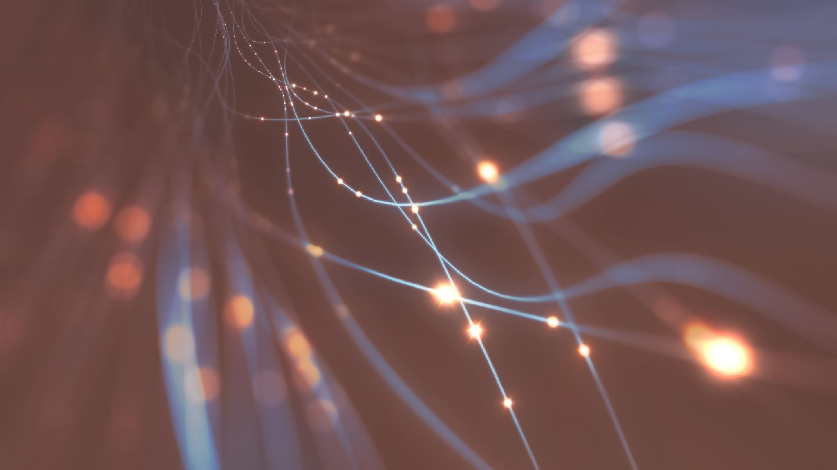
Flip learning
Thursday 26th November 2020
In Autumn 2 – Year 3-4 will be learning about formal and informal letters

Slide 2
Click the link and watch the video
Formal vs Informal writing - YouTube

