Slide 1
Step 6 Tuesday 21st July 2020 Year 3: Lo: I can identify horizontal and vertical lines and pairs of perpendicular and parallel lines

Slide 2
Introduction
Which is the odd one out? Explain your choice.
Name each shape.
Y4

Slide 3
Introduction
Which is the odd one out? Explain your choice.
Example answer:
The pentagon is the odd one out as all of the others are quadrilaterals.
Name each shape.
trapezium
parallelogram
rectangle
square
pentagon
rhombus
Y4

Slide 4
Varied Fluency 1
Draw lines to match the true statements to the shape.
It is a rectangle
It has 5 right angles
It has 3 sides
It has equal sides
It has 4 sides
Y4

Slide 5
Varied Fluency 1
Draw lines to match the true statements to the shape.
It is a rectangle
It has 5 right angles
It has 3 sides
It has equal sides
It has 4 sides
Y4

Slide 6
Varied Fluency 2
Fill in the blanks to describe the shape.
This shape has ______ sides.
It has ______ right angles.
It has ______ pair of parallel sides.
Y4

Slide 7
Varied Fluency 2
Fill in the blanks to describe the shape.
This shape has ______ sides.
It has ______ right angles.
It has ______ pair of parallel sides.
4
0
1
Y4

Slide 8
Varied Fluency 3
Draw the shape using the description below.
The shape has:
4 sides
4 right angles
What shape have you drawn?
Y4

Slide 9
Varied Fluency 3
Draw the shape using the description below.
The shape has:
4 sides
4 right angles
What shape have you drawn?
Y4

Slide 10
Varied Fluency 4
Circle the quadrilaterals.
Y4

Slide 11
Varied Fluency 4
Circle the quadrilaterals.
Y4

Slide 12
Wednesday 22nd July 2020 Lo: I can use reasoning and problem-solving to identify horizontal and vertical lines

Slide 13
Reasoning 1
What is the same about these two shapes?
What is different?
Y4

Slide 14
Reasoning 1
What is the same about these two shapes?
What is different?
Various answers, for example:
Same: 4 sides; 4 right angles; 2 pairs of parallel sides
Different: size; orientation
Y4

Slide 15
Problem Solving 1
Tina is thinking of a shape. It has:
4 equal length sides
No right angles
What shape could Tina be thinking of? Give all possible answers.
Y4

Slide 16
Problem Solving 1
Tina is thinking of a shape. It has:
4 equal length sides
No right angles
What shape could Tina be thinking of? Give all possible answers.
Tina could be thinking of a rhombus.
Y4

Slide 17
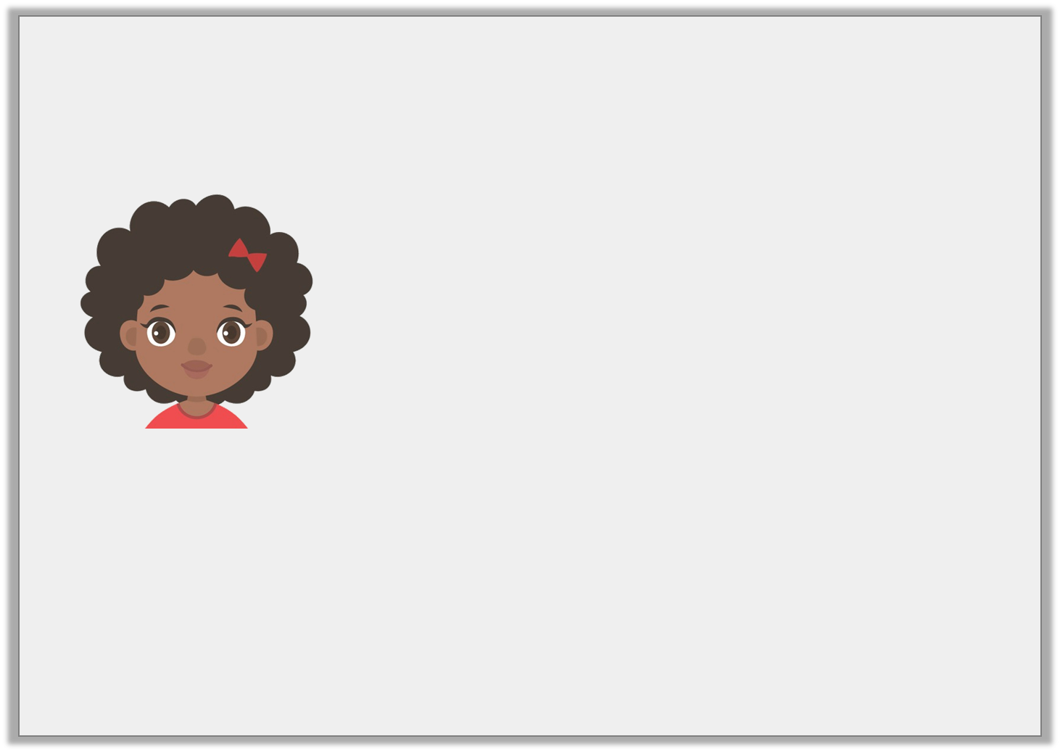
Reasoning 2
Jenny thinks that the shape matches her statement.
Is she correct? Explain your answer.
This quadrilateral has 1 pair of parallel lines and 0 right angles.
Y4

Slide 18
Reasoning 2
Jenny thinks that the shape matches her statement.
Is she correct? Explain your answer.
Jenny is incorrect because…
This quadrilateral has 1 pair of parallel lines and 0 right angles.
Y4

Slide 19
Reasoning 2
Jenny thinks that the shape matches her statement.
Is she correct? Explain your answer.
Jenny is incorrect because this quadrilateral is a parallelogram so it has 2 pairs of parallel lines and no right angles.
This quadrilateral has 1 pair of parallel lines and 0 right angles.
Y4

Slide 20
Step 7 Thursday 23rd July 2020 Year 4:I can draw the lines of symmetry

Slide 21
Introduction
Which of the following shapes have more than one line of symmetry?
Y4

Slide 22
Introduction
Which of the following shapes have more than one line of symmetry?
Y4

Slide 23
Varied Fluency 1
Which shape has the correct lines of symmetry marked?
A
B
C
Y4

Slide 24
Varied Fluency 1
Which shape has the correct lines of symmetry marked?
Shape A
A
B
C
Y4

Slide 25
Varied Fluency 2
Match the halves which go together to make symmetrical shapes.
B
C
A
D
F
E
Y4

Slide 26
Varied Fluency 2
Match the halves which go together to make symmetrical shapes.
A and C; B and D; E and F
B
C
A
D
F
E
Y4

Slide 27
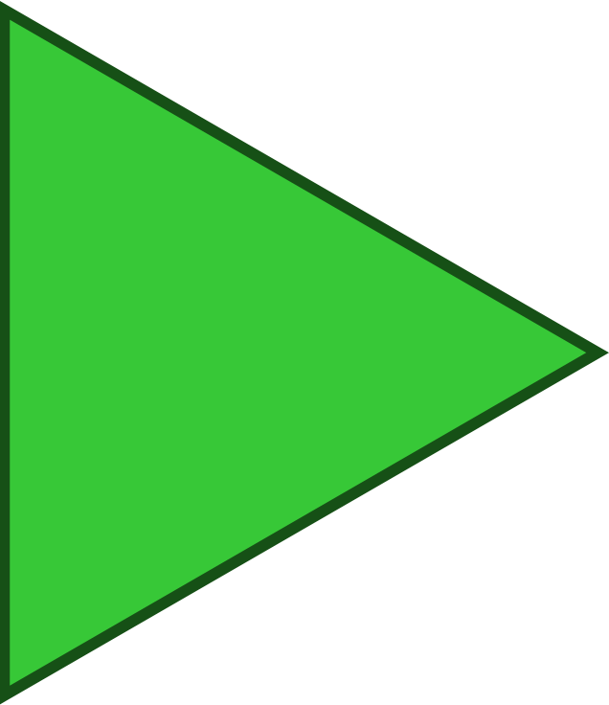
Varied Fluency 3
Pair the lines of symmetry with the shapes they match.
A
B
C
E
D
F
Y4

Slide 28
Varied Fluency 3
Pair the lines of symmetry with the shapes they match.
A and B; C and F; D and E
A
B
C
E
D
F
Y4

Slide 29
Step 7 Friday 24th July 2020 Friday 24th July 2020 Year 4: I can use reasoning problem-solving to draw lines of Symmetry

Slide 30
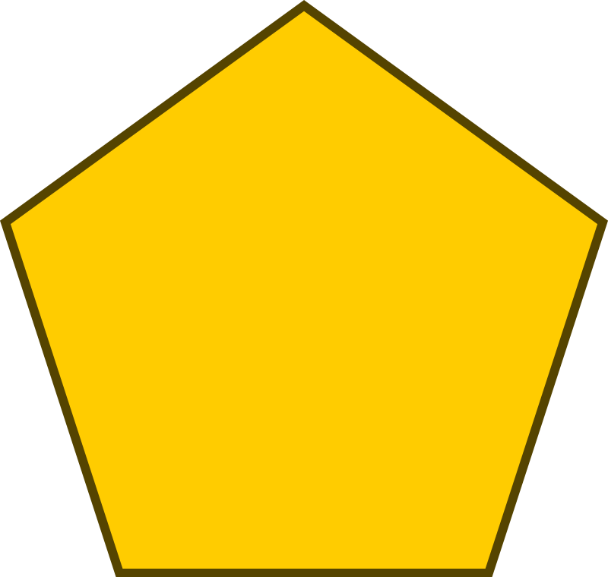
Reasoning 1
Eustace has filled in this Venn diagram with shapes.
Find and explain his mistake.
Vertical line of symmetry
Horizontal line of symmetry
Y4

Slide 31
Reasoning 1
Eustace has filled in this Venn diagram with shapes.
Find and explain his mistake.
Eustace has put the pentagon in the ‘Vertical line of symmetry’ section when in that orientation. It should be in the ‘Horizontal line of symmetry’ section instead.
Vertical line of symmetry
Horizontal line of symmetry
Y4

Slide 32
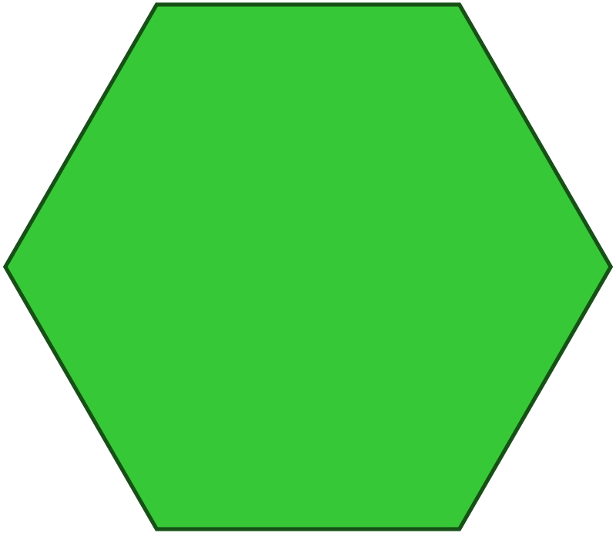
Problem Solving 1
Here is an image made up of several shapes.
How many lines of symmetry does the image (not the individual shapes) have?
Y4

Slide 33
Problem Solving 1
Here is an image made up of several shapes.
How many lines of symmetry does the image (not the individual shapes) have?
The image has 1 line of symmetry.
Y4

Slide 34
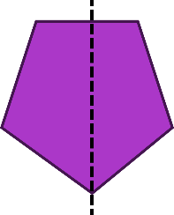
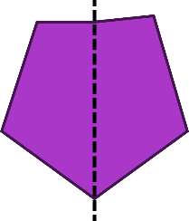
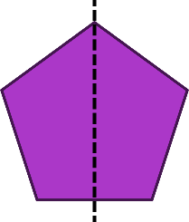
Reasoning 2
Here are 3 attempts at drawing reflections.
Find the reflections that are not symmetrical. Explain why.
A
B
C
Y4

Slide 35
Reasoning 2
Here are 3 attempts at drawing reflections.
Find the reflections that are not symmetrical. Explain why.
Shapes A and B are not symmetrical. The right-hand part of shape A is narrower than the left-hand side. The top-right-hand corner of reflection B is higher and further out than the top-left-hand corner.
A
B
C
Y4

