Slide 1
Varied Fluency 4
How much do these items weigh?
Y2

Slide 2
Varied Fluency 4
How much do these items weigh?
110g
140g
Y2

Slide 3
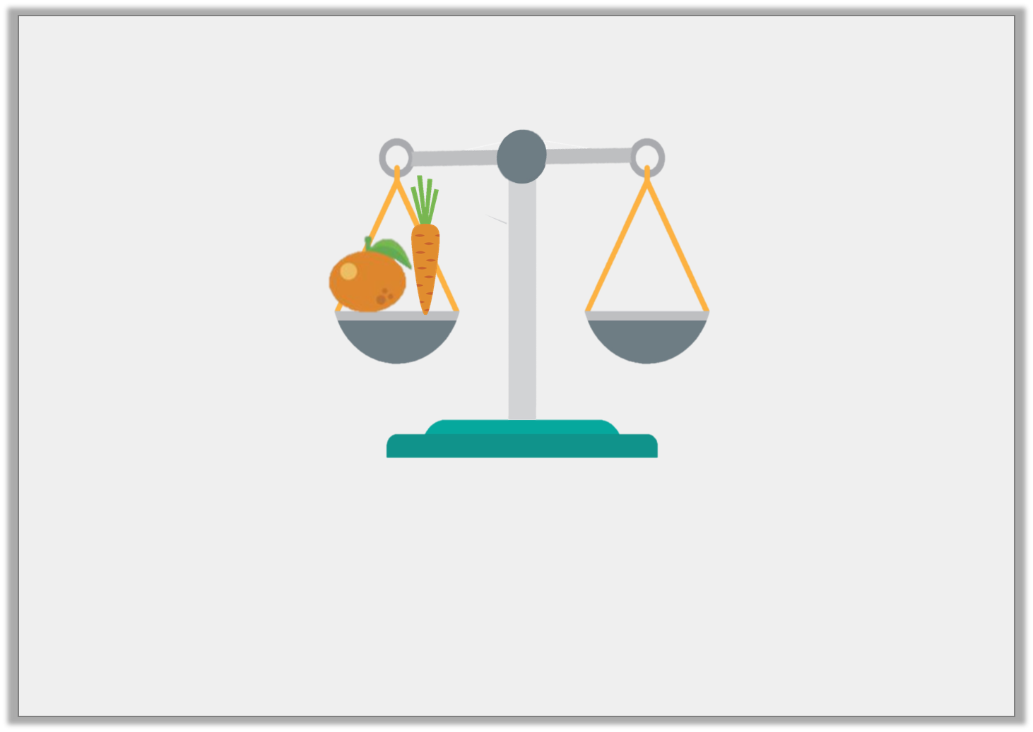
Problem Solving 1
The orange weighs 7 blocks and the carrot weighs 5 blocks.
Draw the blocks to balance the scale.

Slide 4
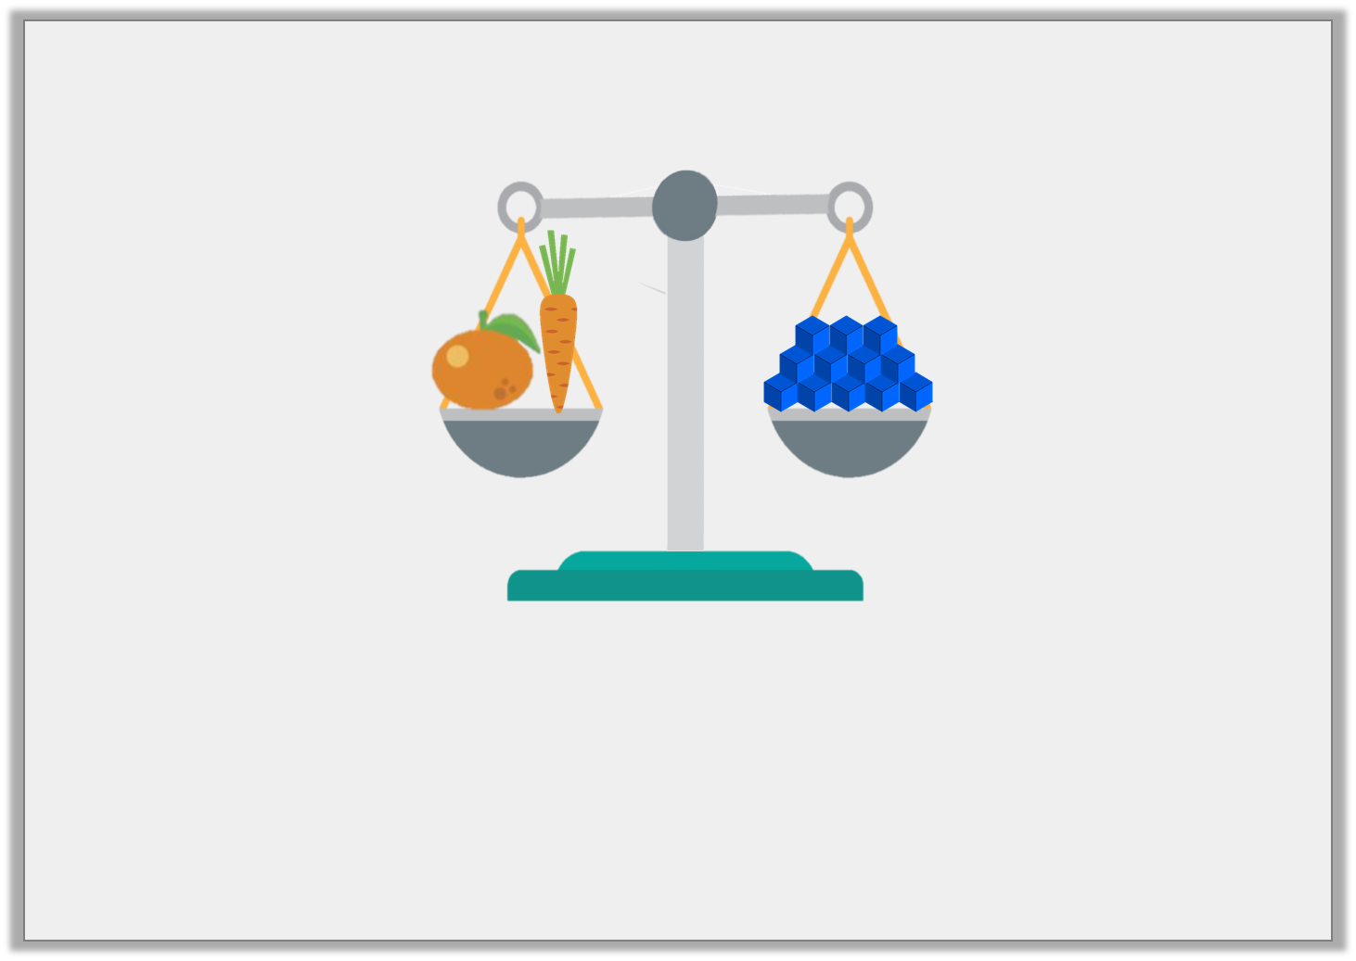
Problem Solving 1
The orange weighs 7 blocks and the carrot weighs 5 blocks.
Draw the blocks to balance the scale.
12 blocks should be drawn on the scale.
Y1

Slide 5
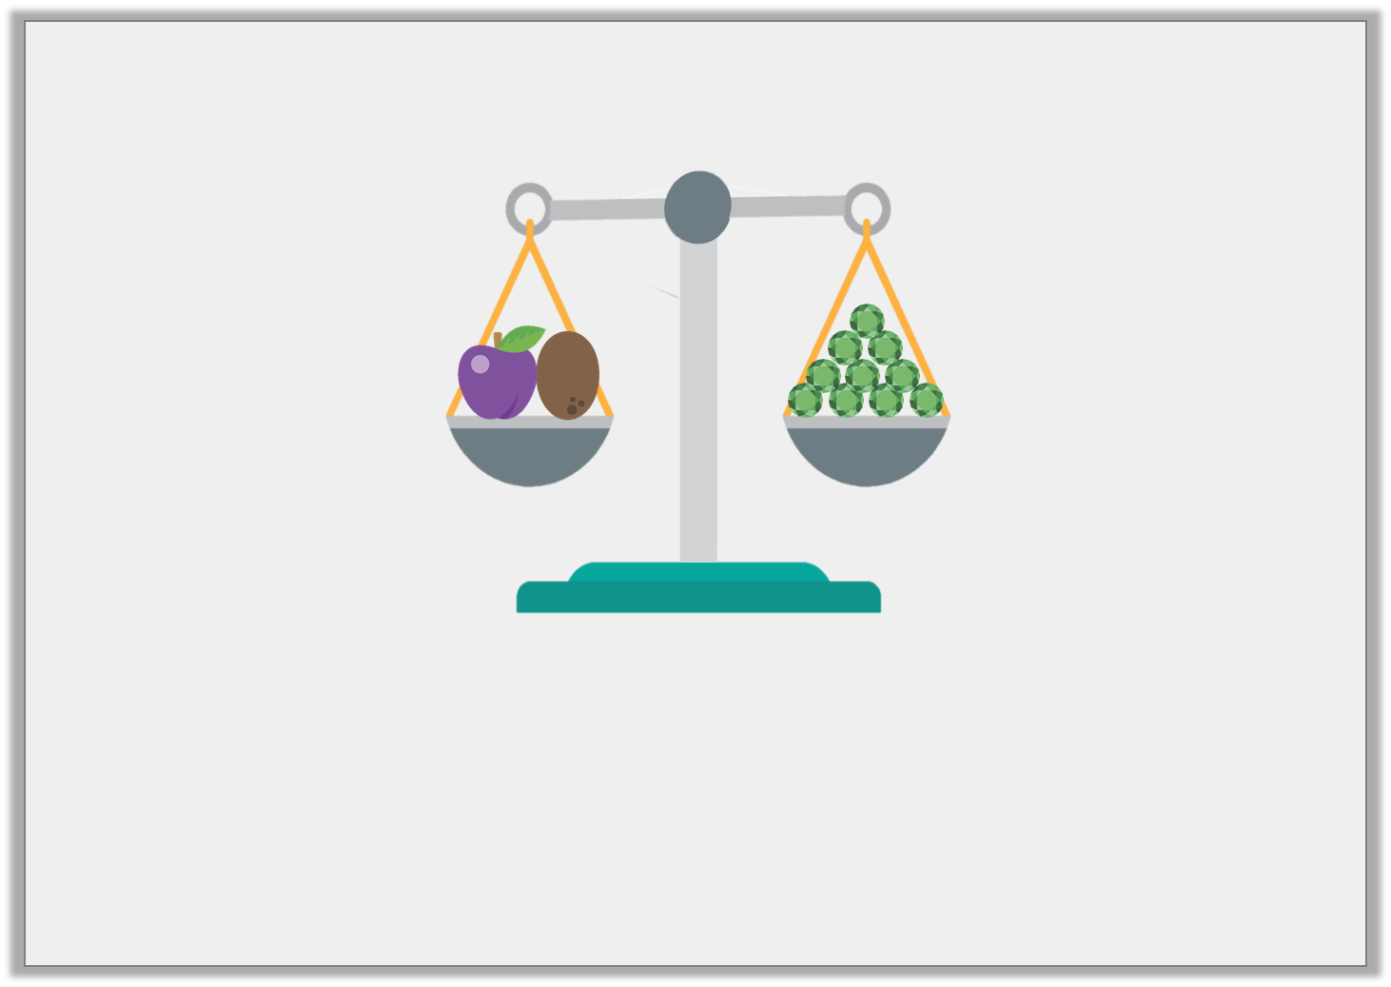
Problem Solving 2
The plum and the kiwi weigh 10 jewels.
Find 3 possible combinations for the mass of the plum and the kiwi.
Y1

Slide 6
Problem Solving 2
The plum and the kiwi weigh 10 jewels.
Find 3 possible combinations for the mass of the plum and the kiwi.
Various answers, for example: plum 4 jewels, kiwi 6 jewels, or plum 3 jewels, kiwi 7 jewels, or plum 9 jewels, kiwi 1 jewel
Y1

Slide 7
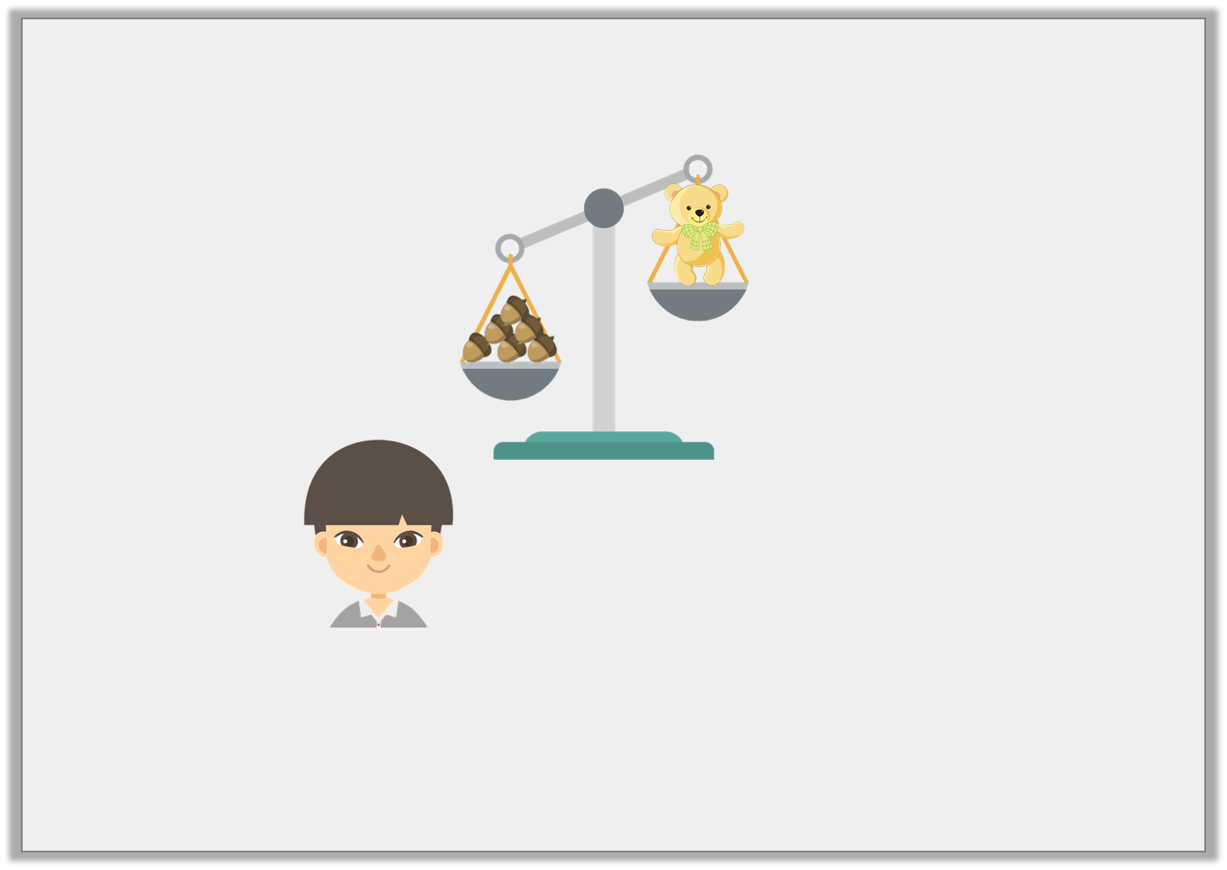
Reasoning 1
Cheng is weighing objects. He says,
Is he correct? Explain your answer.
I think 1 more acorn will balance the scale.
Y1

Slide 8
Reasoning 1
Cheng is weighing objects. He says,
Is he correct? Explain your answer.
No, he is not correct because…
I think 1 more acorn will balance the scale.
Y1

Slide 9
Reasoning 1
Cheng is weighing objects. He says,
Is he correct? Explain your answer.
No, he is not correct because the acorns are already heavier than the teddy. He would need to remove acorns to balance the scale.
I think 1 more acorn will balance the scale.
Y1

