Slide 1
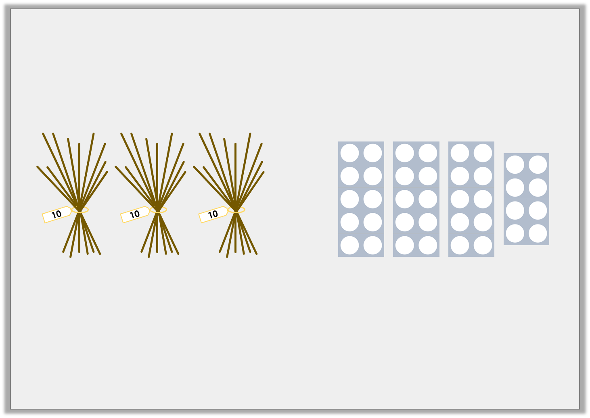
Varied Fluency 3
True or false?
=
Y2

Slide 2
Varied Fluency 3
True or false?
=
False. The correct sign is <.
Y2

Slide 3
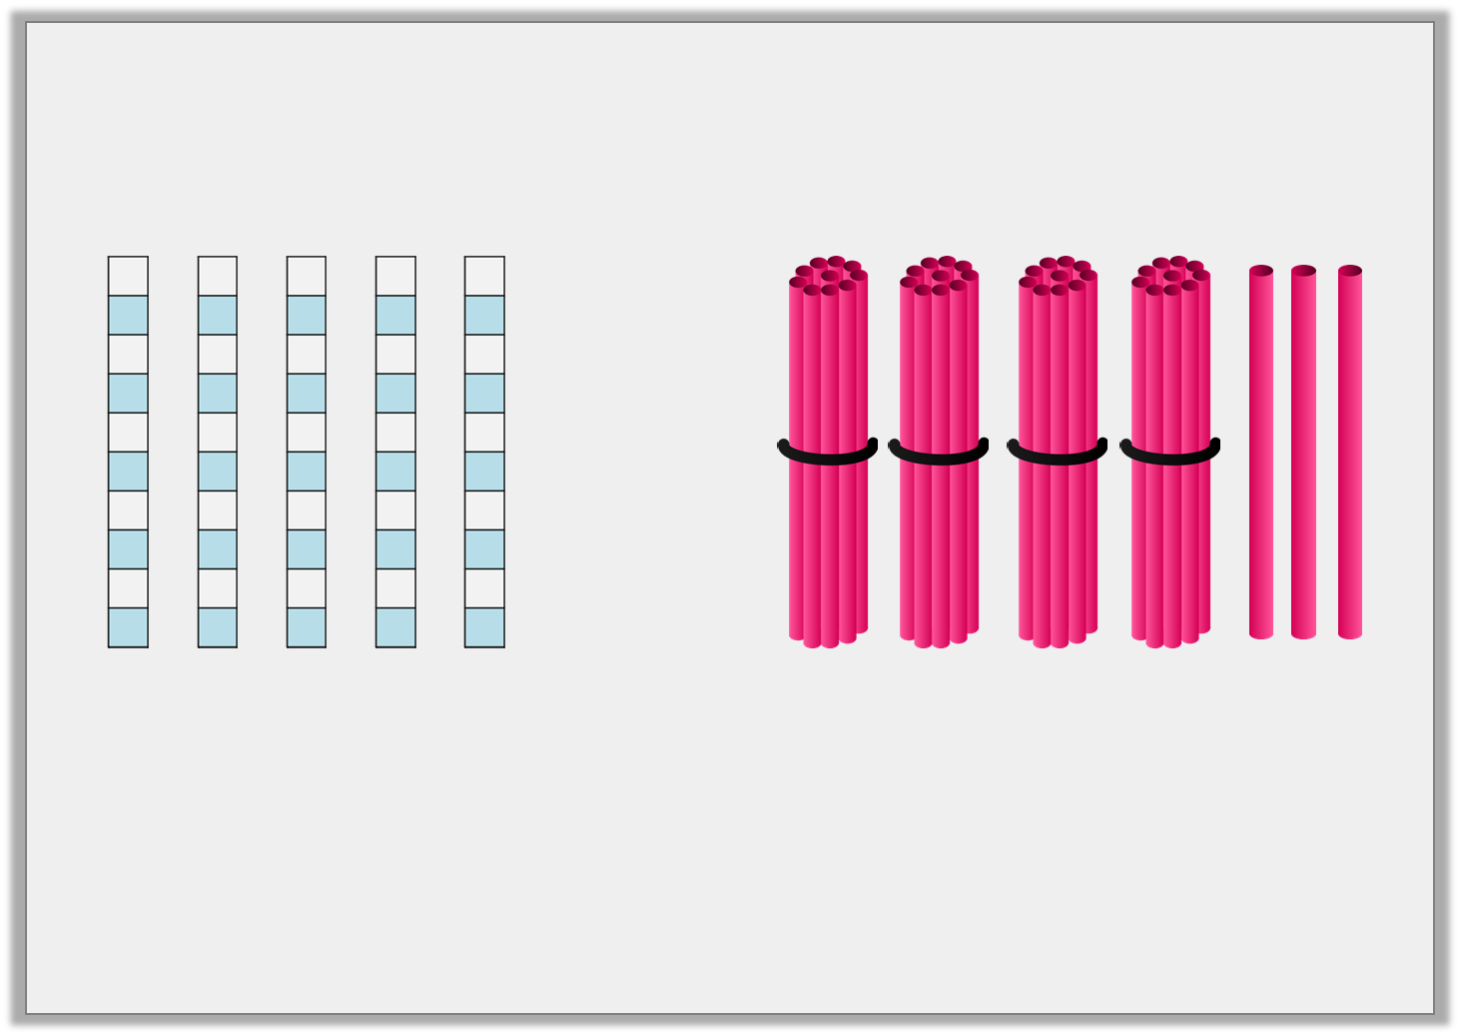
Varied Fluency 4
Complete the statement.
 | is |  | than | 43
more
less
Y2

Slide 4
Varied Fluency 4
Complete the statement.
50 | is | more | than | 43
more
less
Y2

Slide 5
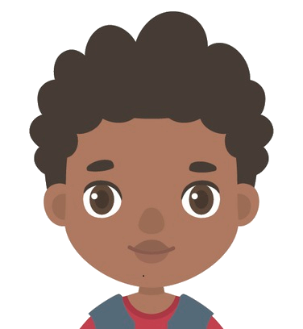
Reasoning 1
The children are comparing groups.
Explain who is correct.
A
B
C
Box A has the most strawberries.
Rav
Box B has the most strawberries.
Tina
Y1

Slide 6
Reasoning 1
The children are comparing groups.
Explain who is correct.
Rav is correct because…
A
B
C
Box A has the most strawberries.
Rav
Box B has the most strawberries.
Tina
Y1

Slide 7
Reasoning 1
The children are comparing groups.
Explain who is correct.
Rav is correct because box A has 18 strawberries which is more than box B with 17 strawberries and box C with 15 strawberries.
A
B
C
Box A has the most strawberries.
Rav
Box B has the most strawberries.
Tina
Y1

Slide 8
Reasoning 2
Betty thinks that box B has the most carrots.
Is she correct? Prove it.
A
B
C
Y1

Slide 9
Reasoning 2
Betty thinks that box B has the most carrots.
Is she correct? Prove it.
Betty is correct because…
A
B
C
Y1

Slide 10
Reasoning 2
Betty thinks that box B has the most carrots.
Is she correct? Prove it.
Betty is correct because box B has 20 carrots which is more than Box A with 14 carrots and Box C with 19 carrots.
A
B
C
Y1

