Slide 1
Year 1/2 – Autumn Block 1 – Place Value
Step 1
Year 1: Count and Write Numbers to 20
Year 2: Count Objects to 100

Slide 2
Introduction
Match the number to the objects or word.
7
10
5
seven
9
six
6
ten
Y1

Slide 3
Introduction
Match the number to the objects or word.
7
10
5
seven
9
six
6
ten
Y1

Slide 4
Introduction
Identify the missing numbers in each row.
1 | 2 |  | 4 |  | 6 |  |  | 9
eleven |  | twelve |  |  |  | fourteen
21 | 22 |  |  | 25 |  | 27 |  |  | 30
thirty-one |  | thirty-two |  |  |  |  |  | thirty-five
 | 42 | 43 |  |  | 46 |  | 48 | 49
Y2

Slide 5
Introduction
Identify the missing numbers in each row.
1 | 2 | 3 | 4 | 5 | 6 | 7 | 8 | 9 | 10
eleven |  | twelve |  | thirteen |  | fourteen |  | fifteen
21 | 22 | 23 | 24 | 25 | 26 | 27 | 28 | 29 | 30
thirty-one |  | thirty-two |  | thirty-three |  | thirty-four |  | thirty-five
41 | 42 | 43 | 44 | 45 | 46 | 47 | 48 | 49 | 50
Y2

Slide 6
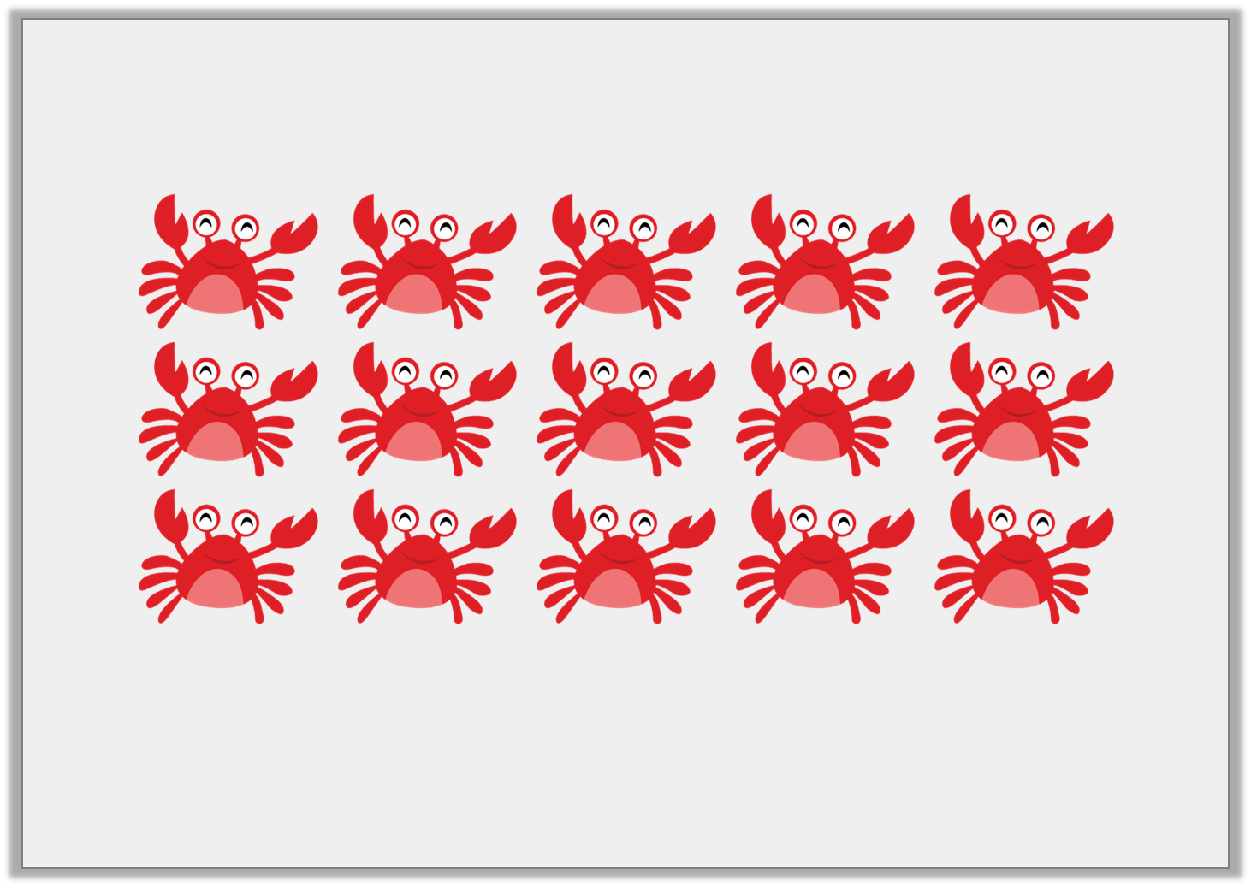
Varied Fluency 1
Count the crabs and write the number in words.
Y1

Slide 7
Varied Fluency 1
Count the crabs and write the number in words.
Fifteen
Y1

Slide 8
Varied Fluency 2
How many cubes are there?
Write your answer as a number and a word.
Y1

Slide 9
Varied Fluency 2
How many cubes are there?
Write your answer as a number and a word.
12 - twelve
Y1

