Slide 1
Reasoning 1
Isla is matching some numbers.
Is she correct? Explain why.
5
thirteen
13
16
17
sixteen
Y1

Slide 2
Reasoning 1
Isla is matching some numbers.
Is she correct? Explain why.
Isla is not correct because…
5
thirteen
13
16
17
sixteen
Y1

Slide 3
Reasoning 1
Isla is matching some numbers.
Is she correct? Explain why.
Isla is not correct because she has matched ‘16’ to ‘seventeen counters’ and ‘17’ to ‘sixteen’.
5
thirteen
13
16
17
sixteen
Y1

Slide 4
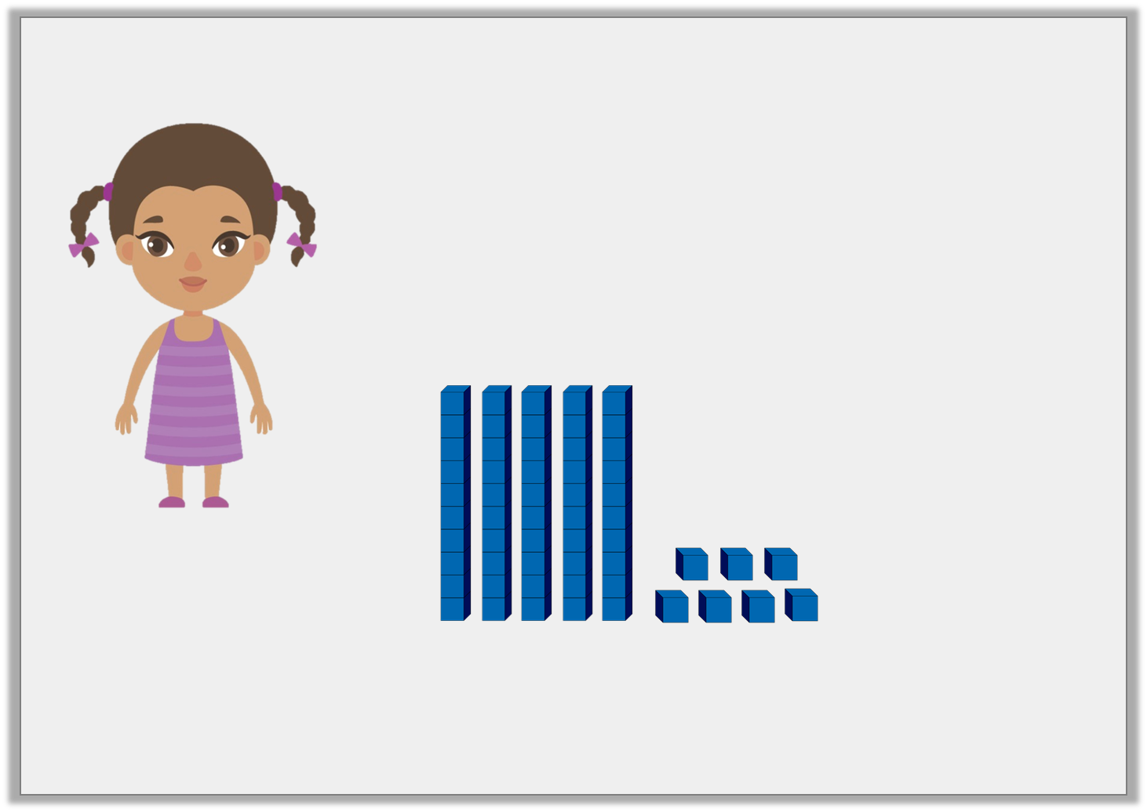
Reasoning 1
Do you agree with Jane?
Explain your answer.
The base 10 shows the number 47.
Jane
Y2

Slide 5
Reasoning 1
Do you agree with Jane?
Explain your answer.
Jane is incorrect because…
The base 10 shows the number 47.
Jane
Y2

Slide 6
Reasoning 1
Do you agree with Jane?
Explain your answer.
Jane is incorrect because…
The base 10 shows the number 47.
Jane
Y2

Slide 7
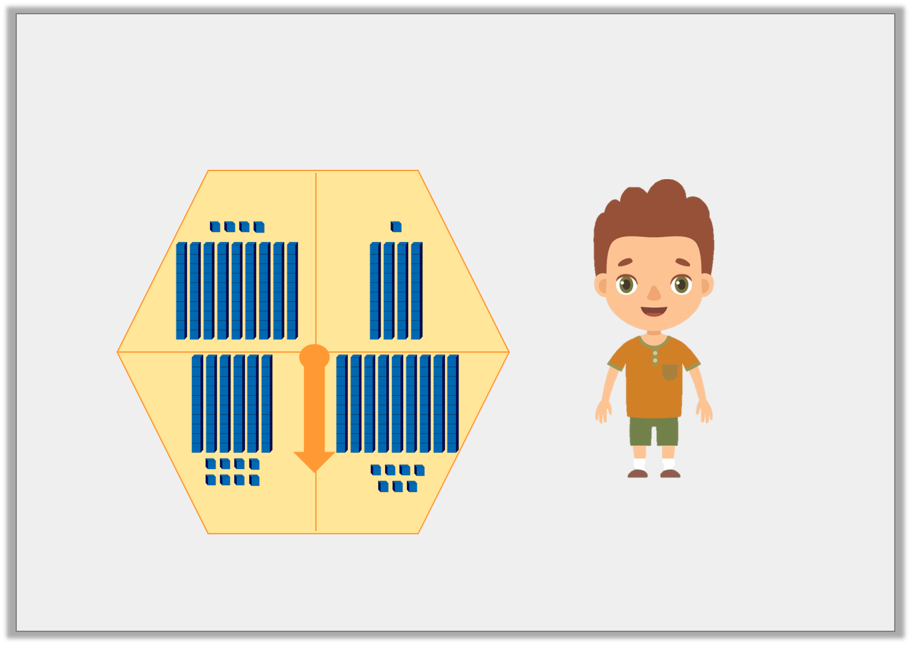
Problem Solving 1
If Derek spins the highest number on his spinner, what will the number be?
Derek
Y2

Slide 8
Problem Solving 1
If Derek spins the highest number on his spinner, what will the number be?
The highest number Derek can spin is 97.
Derek
Y2

Slide 9
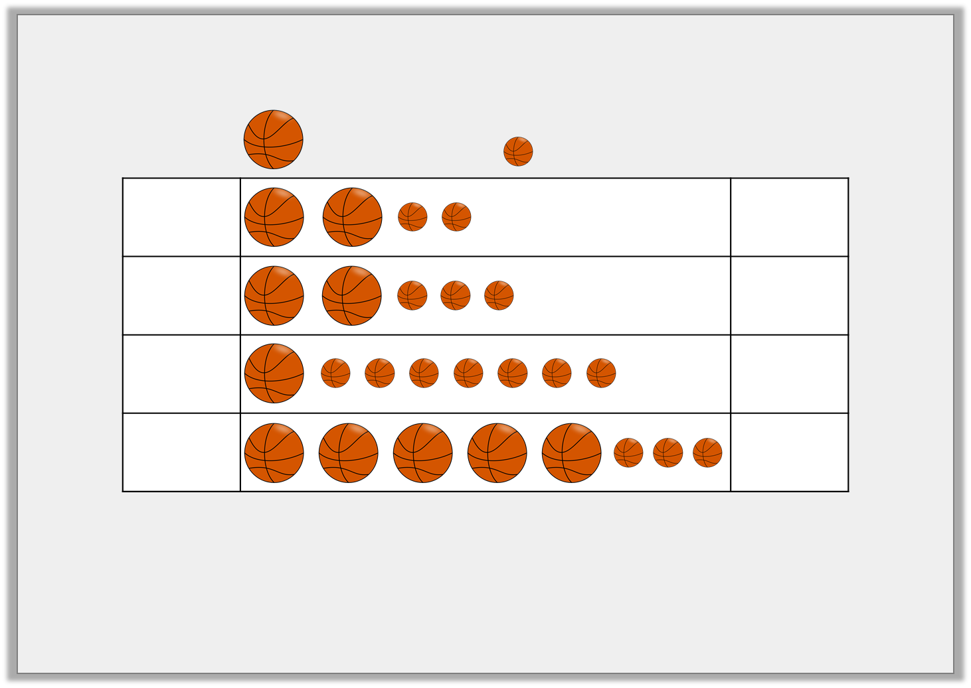
Reasoning 2
Johnny and his friends are practising their basketball skills.
Find and explain the errors in the pictogram.
= 10 points
= 1 point
Rick |  | 22
Tom |  | 32
Bella |  | 70
Freya |  | 53
Y2

Slide 10
Reasoning 2
Johnny and his friends are practising their basketball skills.
Find and explain the errors in the pictogram.
Tom’s number is incorrect because…
= 10 points
= 1 point
Rick |  | 22
Tom |  | 32
Bella |  | 70
Freya |  | 53
Y2

Slide 11
Reasoning 2
Johnny and his friends are practising their basketball skills.
Find and explain the errors in the pictogram.
Tom’s number is incorrect because the pictogram shows 2 tens and 3 ones which makes 23, not 32. The number for Bella is also incorrect as the pictogram shows 1 ten and 7 ones which makes 17, not 70.
= 10 points
= 1 point
Rick |  | 22
Tom |  | 32
Bella |  | 70
Freya |  | 53
Y2

