Slide 1
Year 1/2 – Spring Block 2 – Fractions
About This Resource:
This PowerPoint has been designed to support your teaching of this small step from the Mixed Age planning. It includes a starter activity suitable for each year group and an example of each question from the Varied Fluency and Reasoning and Problem Solving resources also provided in this pack (separate for each year group). Each slide has the year group identified in the bottom right-hand corner. We recommend that you look through this PowerPoint in advance and decide whether to work through all examples provided or a selection of them depending on the needs of your class.
National Curriculum Objectives:
Mathematics Year 1: (1F1b) Recognise, find and name a quarter as one of four equal parts of an object, shape or quantity
Mathematics Year 1: (1M1) Compare, describe and solve practical problems for mass/weight [for example, heavy/light, heavier than, lighter than, half, quarter]
Mathematics Year 2: (2F1a) Recognise, find, name and write fractions 1/3 , 1/4 , 2/4 and 3/4 of a length, shape, set of objects or quantity
Mathematics Year 2: (2F1b) Write simple fractions for example, 1/2 of 6 = 3
More Year 1 and Year 2 Fractions resources.
Did you like this resource? Don’t forget to review it on our website.
© Classroom Secrets Limited 2019

Slide 2
Year 1/2 – Spring Block 2 – Fractions
Step 5
Y1: Finding a Quarter of a Quantity
Y2: Find a Quarter
© Classroom Secrets Limited 2019

Slide 3
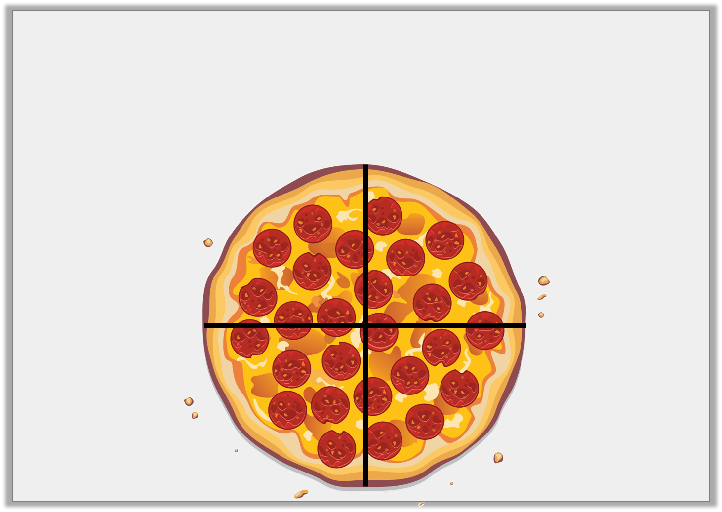
Introduction
How is the pizza split equally?
How is the pizza not split equally?
Y1
© Classroom Secrets Limited 2018

Slide 4
Introduction
How is the pizza split equally?
The pizza is cut into four equal slices.
How is the pizza not split equally?
The slices don’t have the same number of pepperoni pieces on them.
Y1
© Classroom Secrets Limited 2018

Slide 5
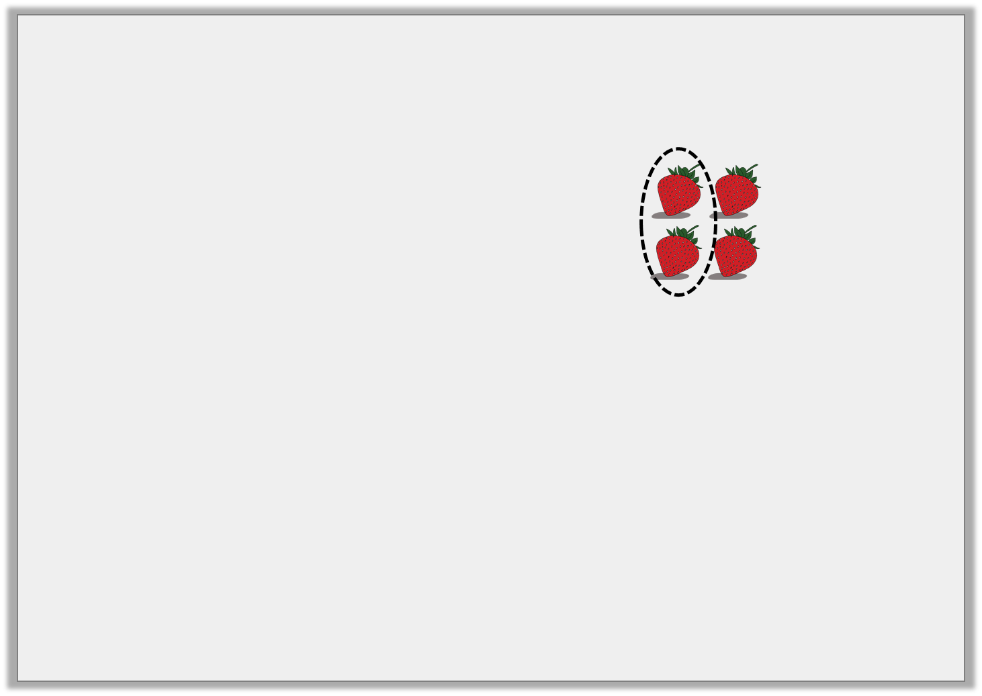
Introduction
Which image is the odd one out?
Y2
© Classroom Secrets Limited 2019

Slide 6
Introduction
Which image is the odd one out?
Y2
© Classroom Secrets Limited 2019

Slide 7
Varied Fluency 1
Complete the statement based on the picture below.
There are ____________ boxes. One quarter of ____________ is ____________ .
Y1
© Classroom Secrets Limited 2018

Slide 8
Varied Fluency 1
Complete the statement based on the picture below.
There are ____________ boxes. One quarter of ____________ is ____________ .
20
20
5
Y1
© Classroom Secrets Limited 2018

Slide 9
Varied Fluency 2
Use the counters to complete the statement.
One quarter of 16 is ________ .
4
Y1
© Classroom Secrets Limited 2018

Slide 10
Varied Fluency 2
Use the counters to complete the statement.
One quarter of 16 is ________ .
4
Y1
© Classroom Secrets Limited 2018

Slide 11
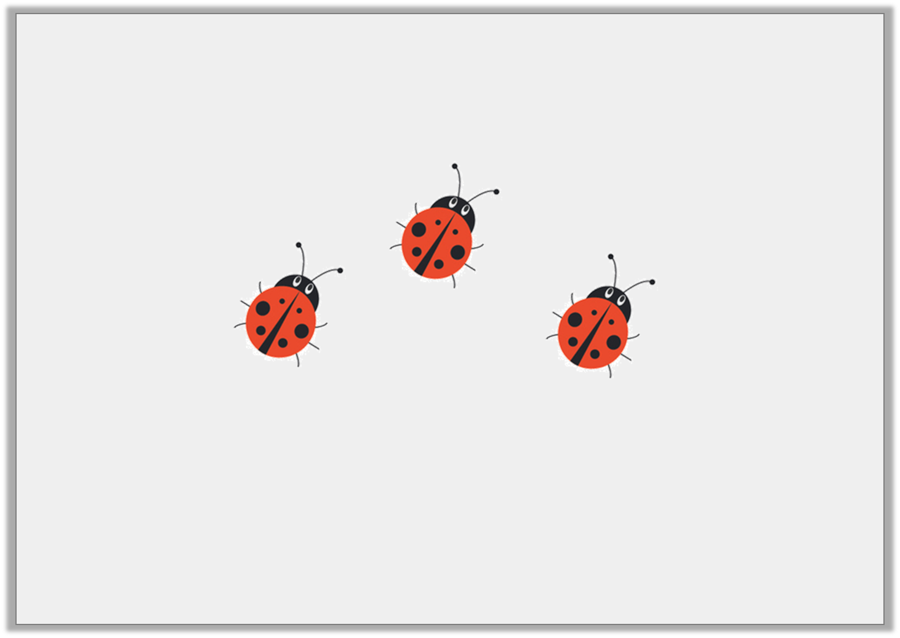
Varied Fluency 3
Here is one quarter.
What is the total?
Y1
© Classroom Secrets Limited 2018

Slide 12
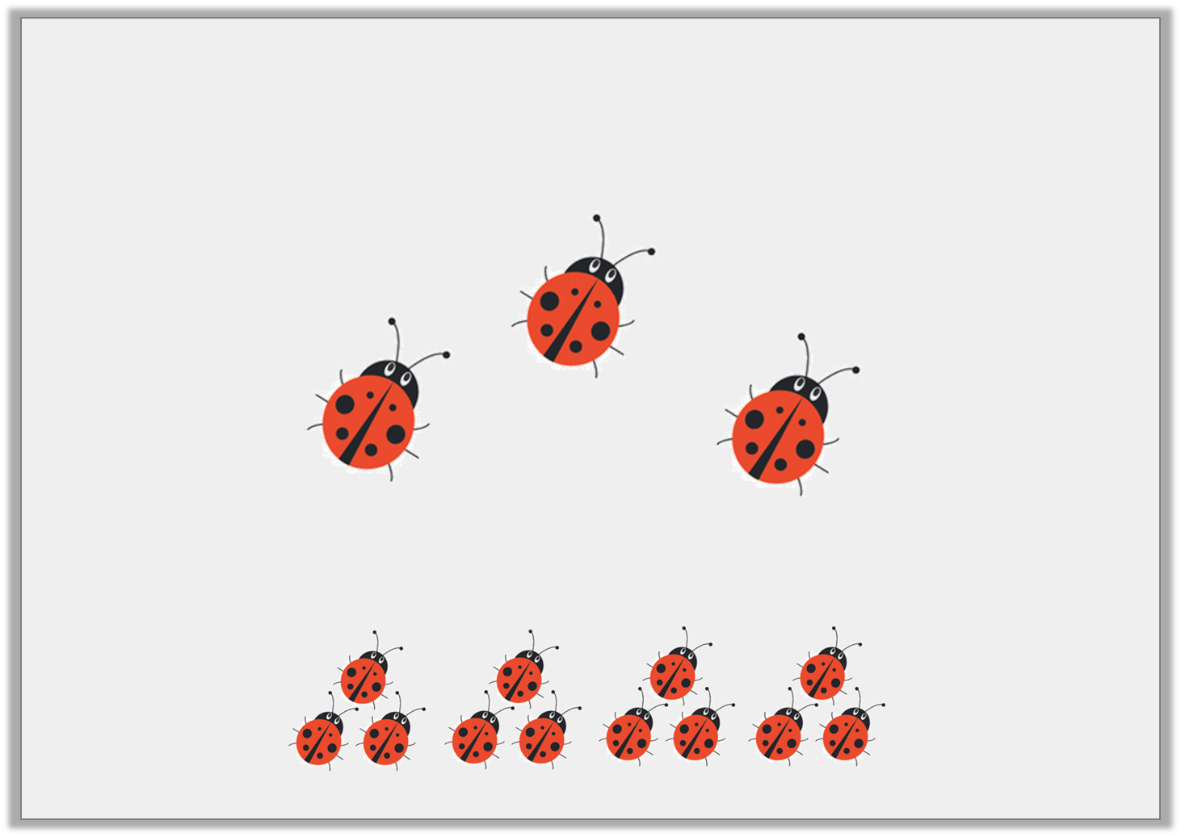
Varied Fluency 3
Here is one quarter.
What is the total? 12
Y1
© Classroom Secrets Limited 2018

Slide 13
Varied Fluency 4
Colour one quarter of these triangles.
Y1
© Classroom Secrets Limited 2018

Slide 14
Varied Fluency 4
Colour one quarter of these triangles.
Any 5 could be coloured, e.g.
Y1
© Classroom Secrets Limited 2018

Slide 15
Varied Fluency 1
Share 16 counters into two equal groups.
of 16 is ______.
Now share the counters into four equal groups.
of 16 is ______.
What do you notice?
1
2
1
4
Y2
© Classroom Secrets Limited 2019

Slide 16
Varied Fluency 1
Share 16 counters into two equal groups.
of 16 is ______.
Now share the counters into four equal groups.
of 16 is ______.
What do you notice?
Four is half of eight.
So, half the whole and half again to find a quarter.
1
2
8
1
4
4
Y2
© Classroom Secrets Limited 2019

Slide 17
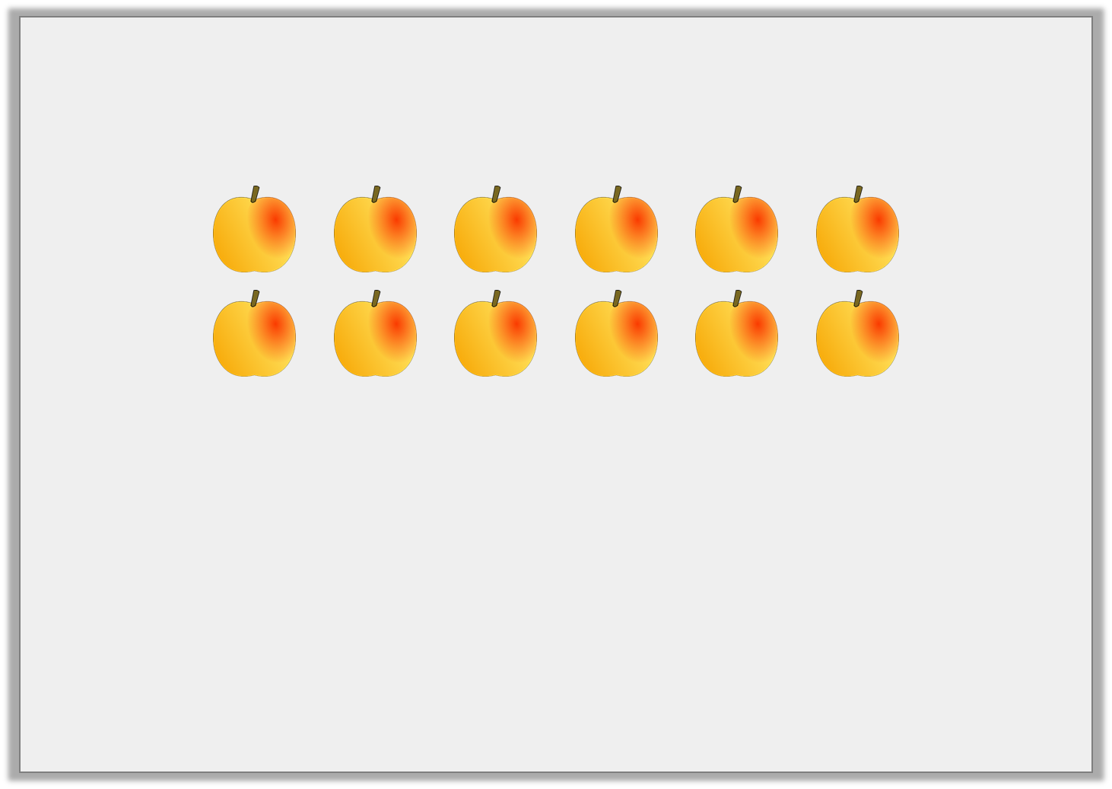
Varied Fluency 2
Find one quarter of the peaches below? Circle the correct answer.
4 |  | 1 |  | 2 |  | 3
Y2
© Classroom Secrets Limited 2019

Slide 18
Varied Fluency 2
Find one quarter of the peaches below? Circle the correct answer.
4 |  | 1 |  | 2 |  | 3
Y2
© Classroom Secrets Limited 2019

Slide 19
Varied Fluency 3
Colour a quarter of the shape and then complete the sentence.
The shape has |  | equal parts.
of |  | is
1
4
Y2
© Classroom Secrets Limited 2019

Slide 20
Varied Fluency 3
Colour a quarter of the shape and then complete the sentence.
Any 2 parts of the shape can be shaded. One suggestion is:
The shape has | 8 | equal parts.
of | 8 | is | 2
1
4
Y2
© Classroom Secrets Limited 2019

Slide 21
Varied Fluency 4
Match the fraction to the answer.
of 12 is
2
1
4
of 8 is
3
1
4
of 16 is
4
1
4
Y2
© Classroom Secrets Limited 2019

Slide 22
Varied Fluency 4
Match the fraction to the answer.
of 12 is
2
1
4
of 8 is
3
1
4
of 16 is
4
1
4
Y2
© Classroom Secrets Limited 2019

Slide 23
Reasoning 1
Lydia thinks she has coloured in one quarter of the cubes. Is she right?
How do you know?
Y1
© Classroom Secrets Limited 2018

Slide 24
Reasoning 1
Lydia thinks she has coloured in one quarter of the cubes. Is she right?
How do you know?
Lydia is wrong because…
Y1
© Classroom Secrets Limited 2018

Slide 25
Reasoning 1
Lydia thinks she has coloured in one quarter of the cubes. Is she right?
How do you know?
Lydia is wrong because there are 12 equal parts and one quarter of 12 is 3.
She needs to colour 3 parts, not 4.
Y1
© Classroom Secrets Limited 2018

Slide 26
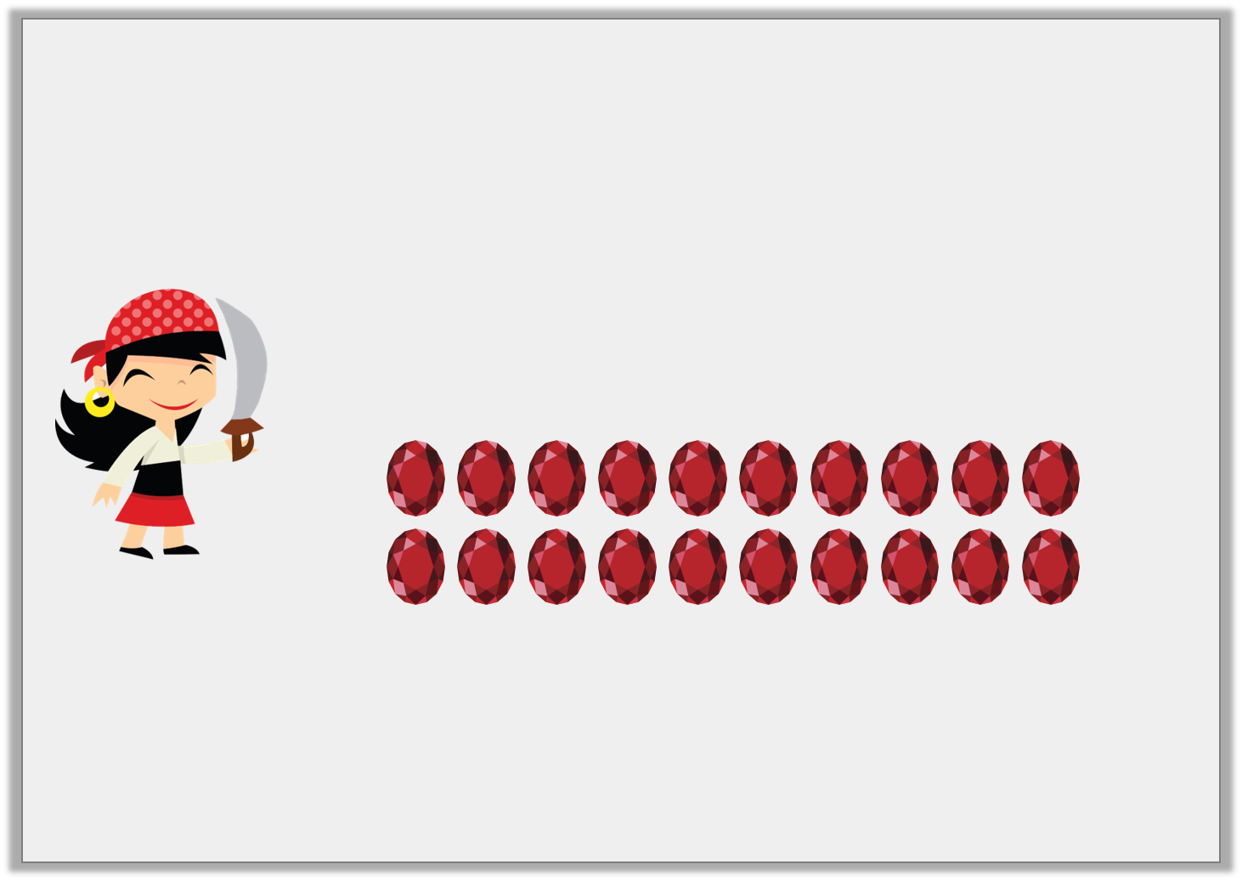
Reasoning 2
Pirate Polly wants to put one quarter of her gems in her treasure chest.
What mistake is Pirate Polly making?
I’m going to put 4 of these gems in my treasure chest.
Y1
© Classroom Secrets Limited 2018

Slide 27
Reasoning 2
Pirate Polly wants to put one quarter of her gems in her treasure chest.
What mistake is Pirate Polly making?
Polly has confused quarters as…
I’m going to put 4 of these gems in my treasure chest.
Y1
© Classroom Secrets Limited 2018

Slide 28
Reasoning 2
Pirate Polly wants to put one quarter of her gems in her treasure chest.
What mistake is Pirate Polly making?
Polly has confused quarters as always being 4 because there are 4 parts, but she has got 20 gems.
A quarter of 20 is 5.
I’m going to put 4 of these gems in my treasure chest.
Y1
© Classroom Secrets Limited 2018

Slide 29
Problem Solving 1
How many different ways can you shade one quarter of the shapes?
Y1
© Classroom Secrets Limited 2018

Slide 30
Problem Solving 1
How many different ways can you shade one quarter of the shapes?
5 parts need to be shaded, e.g.
Y1
© Classroom Secrets Limited 2018

Slide 31
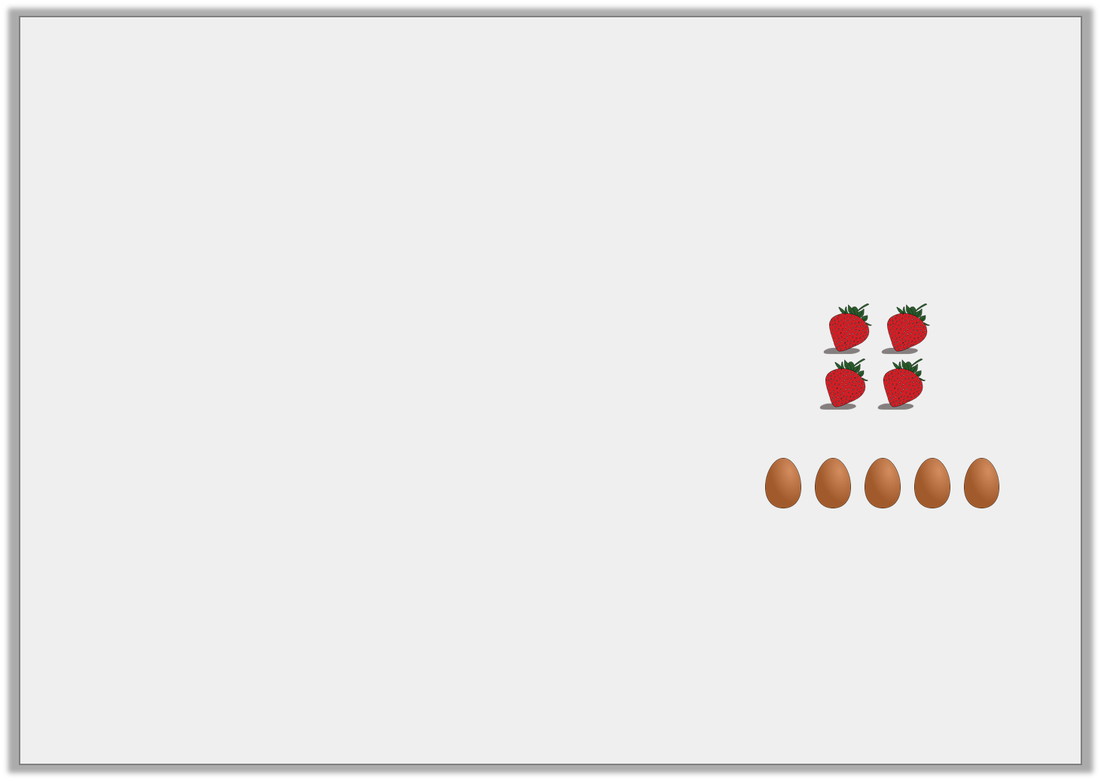
Problem Solving 1
Match the statement to the correct quarter. Which is the odd one out?
1 | of 8
4
1 | of 16
4
1 | of 12
4
two
Y2
© Classroom Secrets Limited 2019

Slide 32
Problem Solving 1
Match the statement to the correct quarter. Which is the odd one out?
5 eggs is the odd one out.
1 | of 8
4
1 | of 16
4
1 | of 12
4
two
Y2
© Classroom Secrets Limited 2019

Slide 33
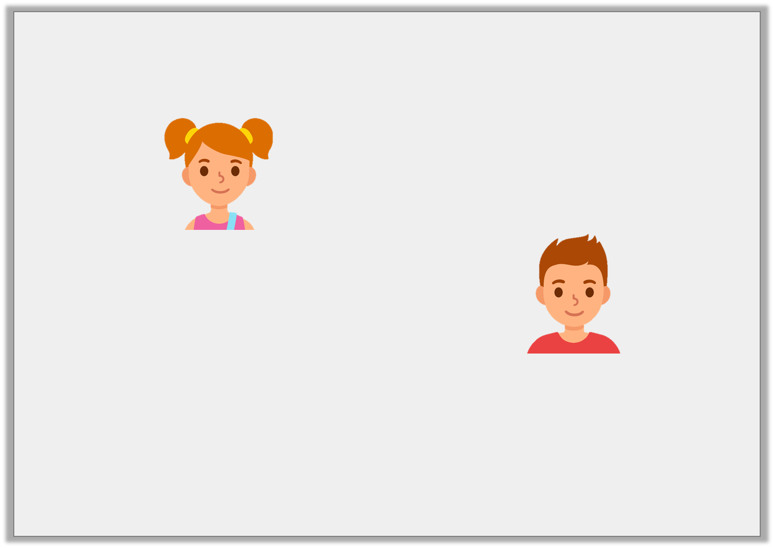
Reasoning 1
Sara and Tom are talking about quarters.
Who is correct? Convince me.
of 16cm = 4cm.
1
4
of 16cm = 3cm.
1
4
Y2
© Classroom Secrets Limited 2019

Slide 34
Reasoning 1
Sara and Tom are talking about quarters.
Who is correct? Convince me.
Sara is correct because…
of 16cm = 4cm.
1
4
of 16cm = 3cm.
1
4
Y2
© Classroom Secrets Limited 2019

Slide 35
Reasoning 1
Sara and Tom are talking about quarters.
Who is correct? Convince me.
Sara is correct because 16cm split into 4 equal parts is 4cm.
of 16cm = 4cm.
1
4
of 16cm = 3cm.
1
4
Y2
© Classroom Secrets Limited 2019

Slide 36
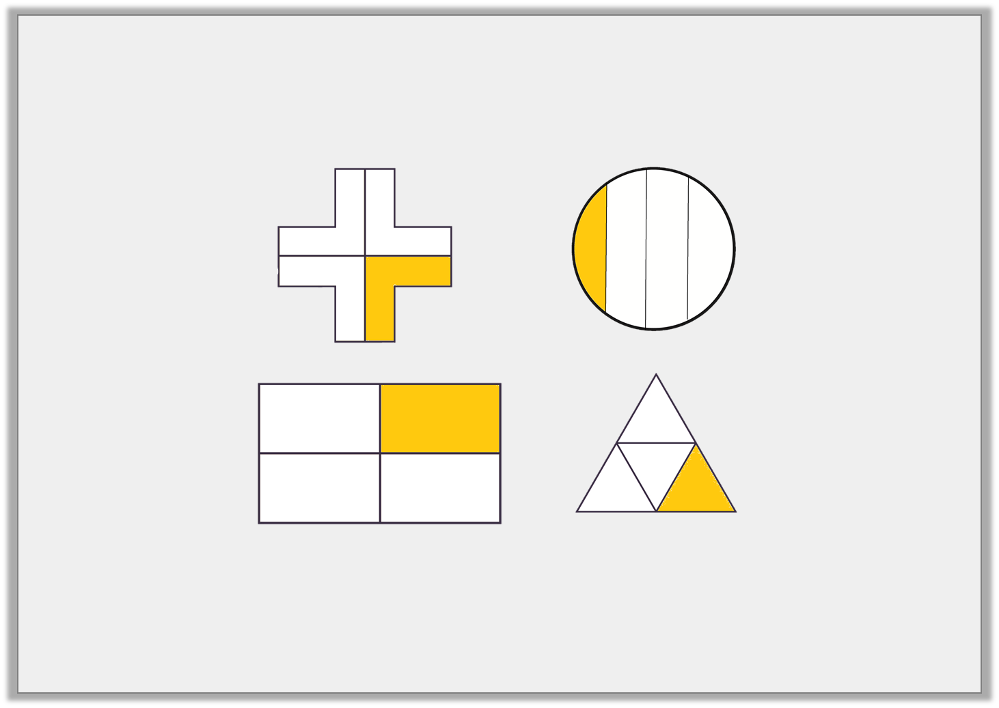
Reasoning 2
Charlie has been asked to divide and shade one quarter of each shape.
Is he correct? Explain why or why not.
Y2
© Classroom Secrets Limited 2019

Slide 37
Reasoning 2
Charlie has been asked to divide and shade one quarter of each shape.
Is he correct? Explain why or why not.
The circle is incorrect because…
Y2
© Classroom Secrets Limited 2019

Slide 38
Reasoning 2
Charlie has been asked to divide and shade one quarter of each shape.
Is he correct? Explain why or why not.
The circle is incorrect because the 4 parts are not equal.
Y2
© Classroom Secrets Limited 2019

