Slide 1
Year 3/4 – Spring Block 4 – Fractions and Decimals
Step 10
03/04.20
Year 4: to recognise and write the hundredths as decimals
© Classroom Secrets Limited 2019

Slide 2
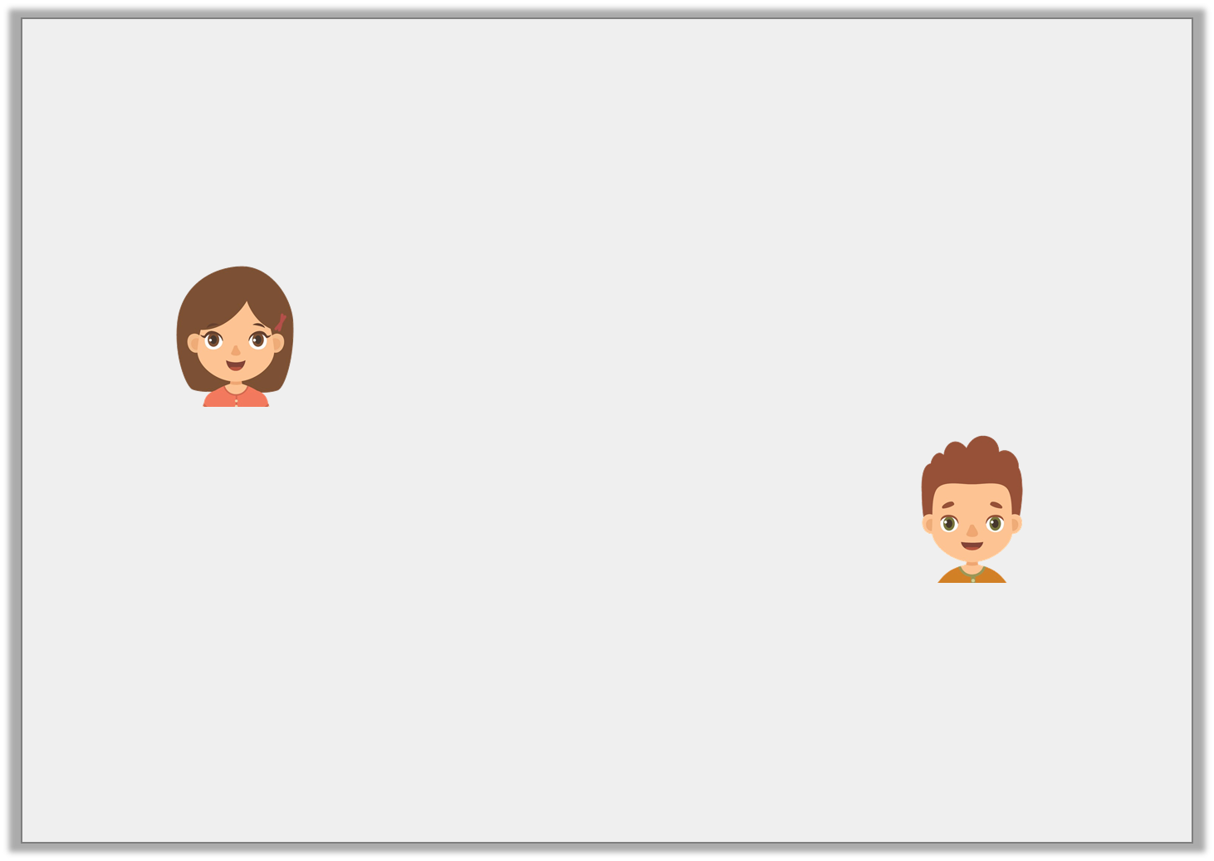
Reasoning 1
Who is correct?
Explain your answer.
5 | = | 0.05
100
This decimal is correct as it shows 50 hundredths.
Helen
This decimal is correct because it shows 5 hundredths.
Carl
Y4
© Classroom Secrets Limited 2019

Slide 3
Reasoning 1
Who is correct?
Explain your answer.
Carl is correct because...
5 | = | 0.05
100
This decimal is correct as it shows 50 hundredths.
Helen
This decimal is correct because it shows 5 hundredths.
Carl
Y4
© Classroom Secrets Limited 2019

Slide 4
Reasoning 1
Who is correct?
Explain your answer.
Carl is correct because the decimal has 5 hundredths and zero tenths. 50 hundredths would be 0.5 as a decimal.
5 | = | 0.05
100
This decimal is correct as it shows 50 hundredths.
Helen
This decimal is correct because it shows 5 hundredths.
Carl
Y4
© Classroom Secrets Limited 2019

Slide 5
Problem Solving 1
Use the digit cards to make three decimals less than one.
Write the equivalent fraction for each decimal you create.
4
6
0
0
Y4
© Classroom Secrets Limited 2019

Slide 6
Problem Solving 1
Use the digit cards to make three decimals less than one.
Write the equivalent fraction for each decimal you create.
Various answers, for example: 0.06 =
0.64 = , 0.40 =
4
6
0
0
6
100
64
100
40
100
Y4
© Classroom Secrets Limited 2019

Slide 7
Reasoning 2
Is this statement correct?
Explain your answer.
0.22 | > | 0.02
Y4
© Classroom Secrets Limited 2019

Slide 8
Reasoning 2
Is this statement correct?
Explain your answer.
Yes, the statement is correct because…
0.22 | > | 0.02
Y4
© Classroom Secrets Limited 2019

Slide 9
Reasoning 2
Is this statement correct?
Explain your answer.
Yes, the statement is correct because twenty two hundredths are greater than 2 hundredths.
0.22 | > | 0.02
Y4
© Classroom Secrets Limited 2019

