Slide 1
Year 3/4 – Summer Block 5 – Mass and Capacity
01.04.20
Year 3:
Lo: I can add and subtract mass using reasoning and problem- solving
© Classroom Secrets Limited 2018

Slide 2
Problem Solving 1
Yusuf is packing for his holiday. The maximum weight of his suitcase is 10kg. Find all of the possible combinations of three items he could put in his case. You must include the weight of the case.
Case – 4kg and 700g
Toiletry bag – 650g
Shoes – 1400g
Clothes – 2kg and 100g
Swimwear – 850g
Inflatable toy and pump – 2kg and 400g
Y3
© Classroom Secrets Limited 2018

Slide 3
Problem Solving 1
Yusuf is packing for his holiday. The maximum weight of his suitcase is 10kg. Find all of the possible combinations of three items he could put in his case. You must include the weight of the case.
Case – 4kg and 700g
Toiletry bag – 650g
Shoes – 1400g
Clothes – 2kg and 100g
Swimwear – 850g
Inflatable toy and pump – 2kg and 400g
Various answers, for example:
Inflatable toy and pump, shoes and swimwear (9kg and 350g)
Inflatable toy and pump, shoes and toiletry bag (9kg and150g)
Clothes, shoes and toiletry bag (8kg and 850g)
Y3
© Classroom Secrets Limited 2018

Slide 4
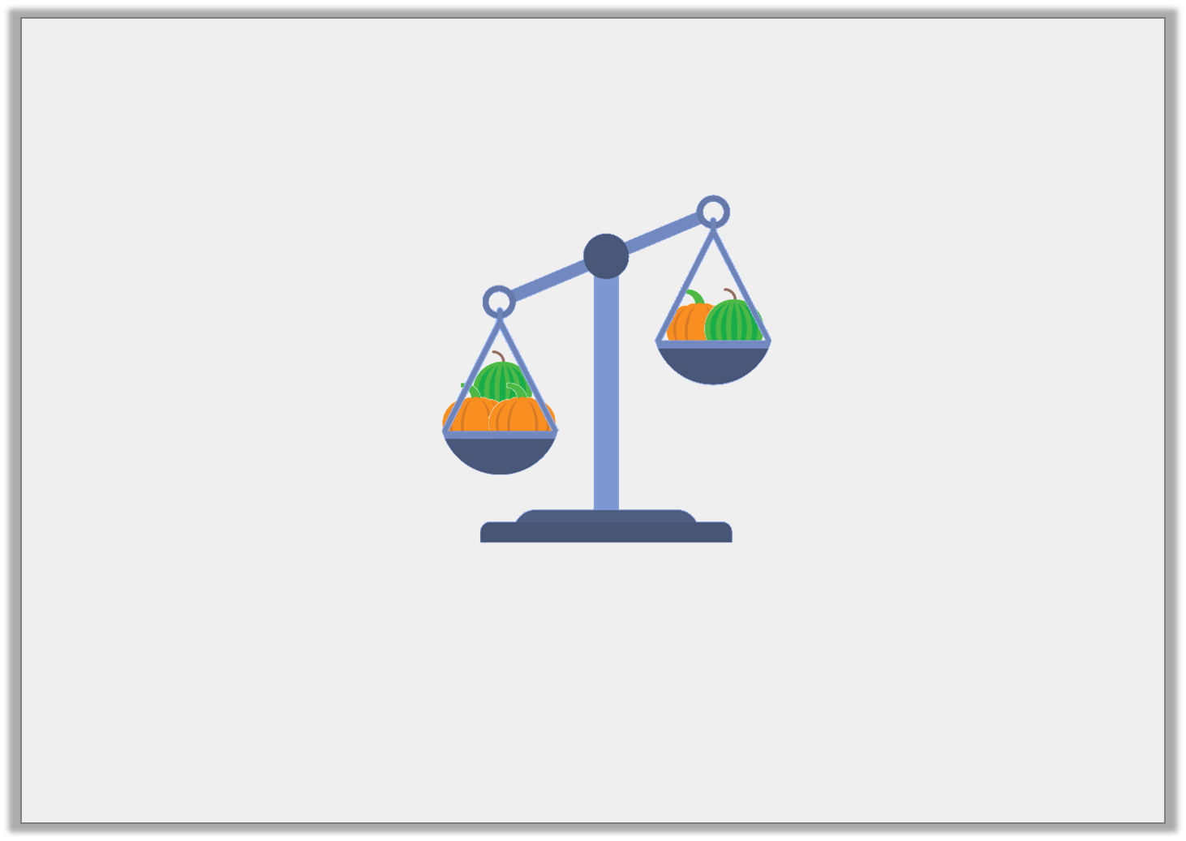
Reasoning 1
Liam adds another pumpkin to the right side of the scale. What will happen to the scale?
1kg and 400g
2kg and 150g
Y3
© Classroom Secrets Limited 2018

Slide 5
Reasoning 1
Liam adds another pumpkin to the right side of the scale. What will happen to the scale?
A pumpkin must weigh 750g because…
A watermelon must weigh 650g because…
The scale will balance because…
1kg and 400g
2kg and 150g
Y3
© Classroom Secrets Limited 2018

Slide 6
Reasoning 1
Liam adds another pumpkin to the right side of the scale. What will happen to the scale?
A pumpkin must weigh 750g because 2kg and 150g – 1kg and 400g = 750g.
A watermelon must weigh 650g because 1kg and 400g – 750g = 650g.
The scale will balance because 1kg and 400g + 750g = 2kg and 150g.
1kg and 400g
2kg and 150g
Y3
© Classroom Secrets Limited 2018

Slide 7
Problem Solving 1
Which missing weight is the odd one out – A, B or C? Convince me.
1kg and 305g | 450g | A
4,200g
620g | 300g | 1kg and 645g
B
535g
1kg and 700g
330g
C
Y3
© Classroom Secrets Limited 2018

Slide 8
Problem Solving 1
Which missing weight is the odd one out – A, B or C? Convince me.
A is the odd one out because 4k 200g – 1kg 775g = 2kg 445g whereas both B and C equal 2kg 565g or 2,565g.
1kg and 305g | 450g | A
4,200g
620g | 300g | 1kg and 645g
B
535g
1kg and 700g
330g
C
Y3
© Classroom Secrets Limited 2018

