Slide 1


Year 3/4 – Summer Block 5 – Mass and Capacity
02/04.20
Year 3
Lo: I can measure capacity 1
© Classroom Secrets Limited 2018

Slide 2
Introduction
Complete the missing numbers in these sequences.
50 |  | 100 |  |  |  | 200
100 |  |  |  | 300 |  |  |  | 500
 |  | 100 |  |  |  | 200
A
B
C
Y3
© Classroom Secrets Limited 2018

Slide 3
Introduction
Complete the missing numbers in these sequences.
50 |  | 100 |  | 150 |  | 200 |  | 250
100 |  | 200 |  | 300 |  | 400 |  | 500
50 |  | 100 |  | 150 |  | 200 |  | 250
A
B
C
Y3
© Classroom Secrets Limited 2018

Slide 4
Varied Fluency 1
Complete the sentence.
The capacity is millilitres.
150ml
50ml
Y3
© Classroom Secrets Limited 2018

Slide 5
Varied Fluency 1
Complete the sentence.
The capacity is millilitres.
150ml
50ml
250
Y3
© Classroom Secrets Limited 2018

Slide 6
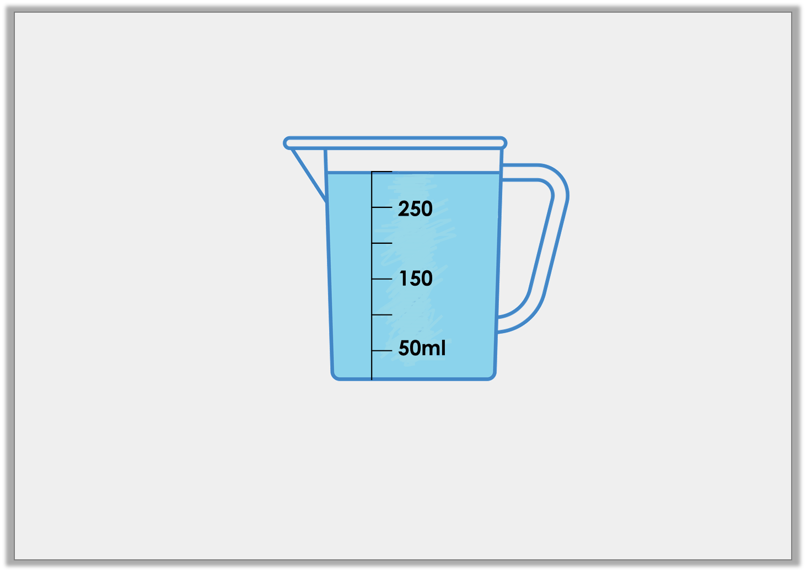
Varied Fluency 2
True or false? There are 300ml of liquid in the jug below.
Y3
© Classroom Secrets Limited 2018

Slide 7
Varied Fluency 2
True or false? There are 300ml of liquid in the jug below.
True
Y3
© Classroom Secrets Limited 2018

Slide 8
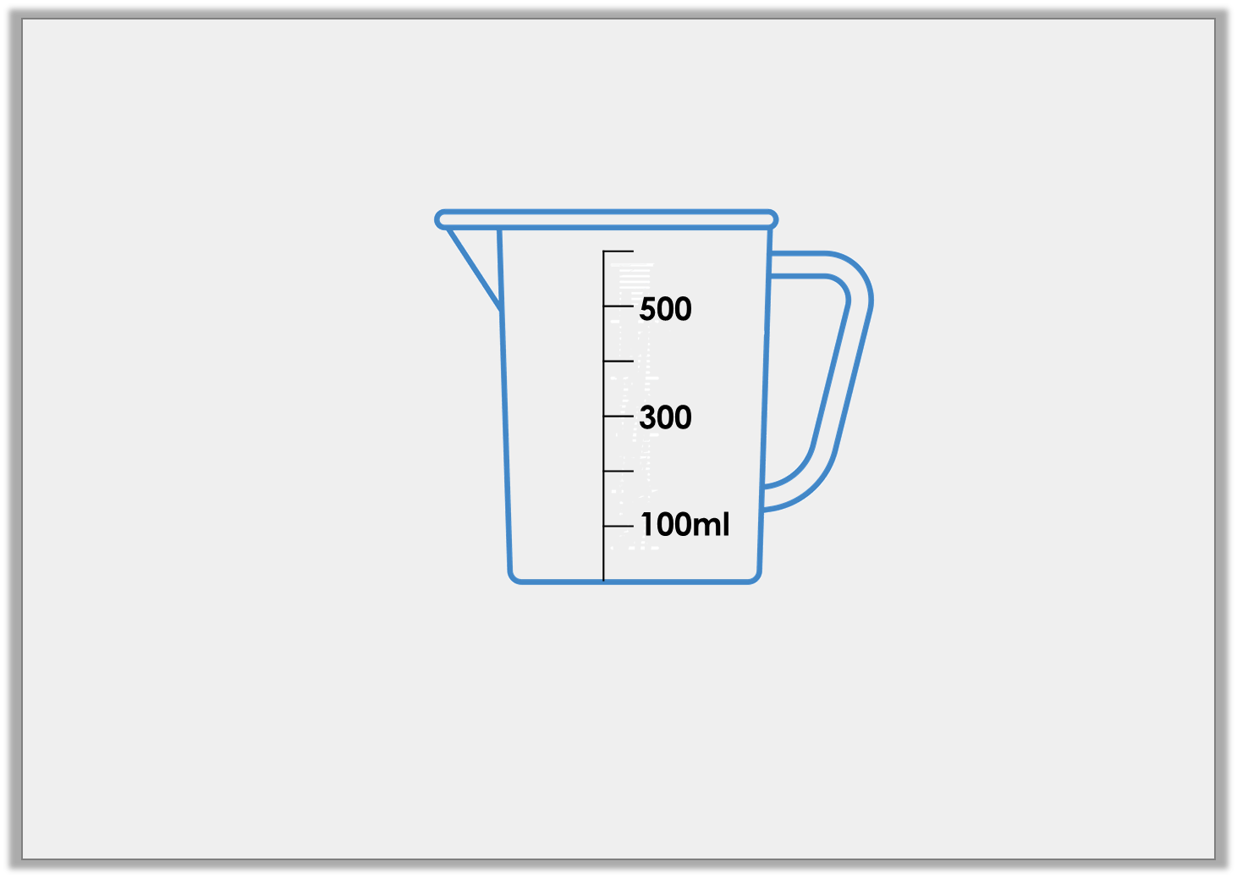
Varied Fluency 3
Draw an arrow to show the water level for a volume of 200ml.
Y3
© Classroom Secrets Limited 2018

Slide 9
Varied Fluency 3
Draw an arrow to show the water level for a volume of 200ml.
Y3
© Classroom Secrets Limited 2018

Slide 10
Varied Fluency 4
Match the volumes to the correct containers.
A
B
C
200ml
100ml
300
100ml
4L
2L
200ml
3LL
150ml
Y3
© Classroom Secrets Limited 2018

Slide 11
Varied Fluency 4
Match the volumes to the correct containers.
A
B
C
200ml
100ml
300
100ml
4L
2L
200ml
3LL
150ml
Y3
© Classroom Secrets Limited 2018

