Slide 1


Year 3/4 – Summer Block 5 – Mass and Capacity
03/04.20
Year 3 Lo: I can measure capacity 1
© Classroom Secrets Limited 2018

Slide 2
Reasoning 1
Which is the odd one out? Explain your answer.
A
B
C
150ml
50ml
300
100ml
400ml
200ml
Y3
© Classroom Secrets Limited 2018

Slide 3
Reasoning 1
Which is the odd one out? Explain your answer.
B is the odd one out because the volume of liquid in both A and C is 200ml but the volume in C id 150ml.
A
B
C
150ml
50ml
300
100ml
400ml
200ml
Y3
© Classroom Secrets Limited 2018

Slide 4
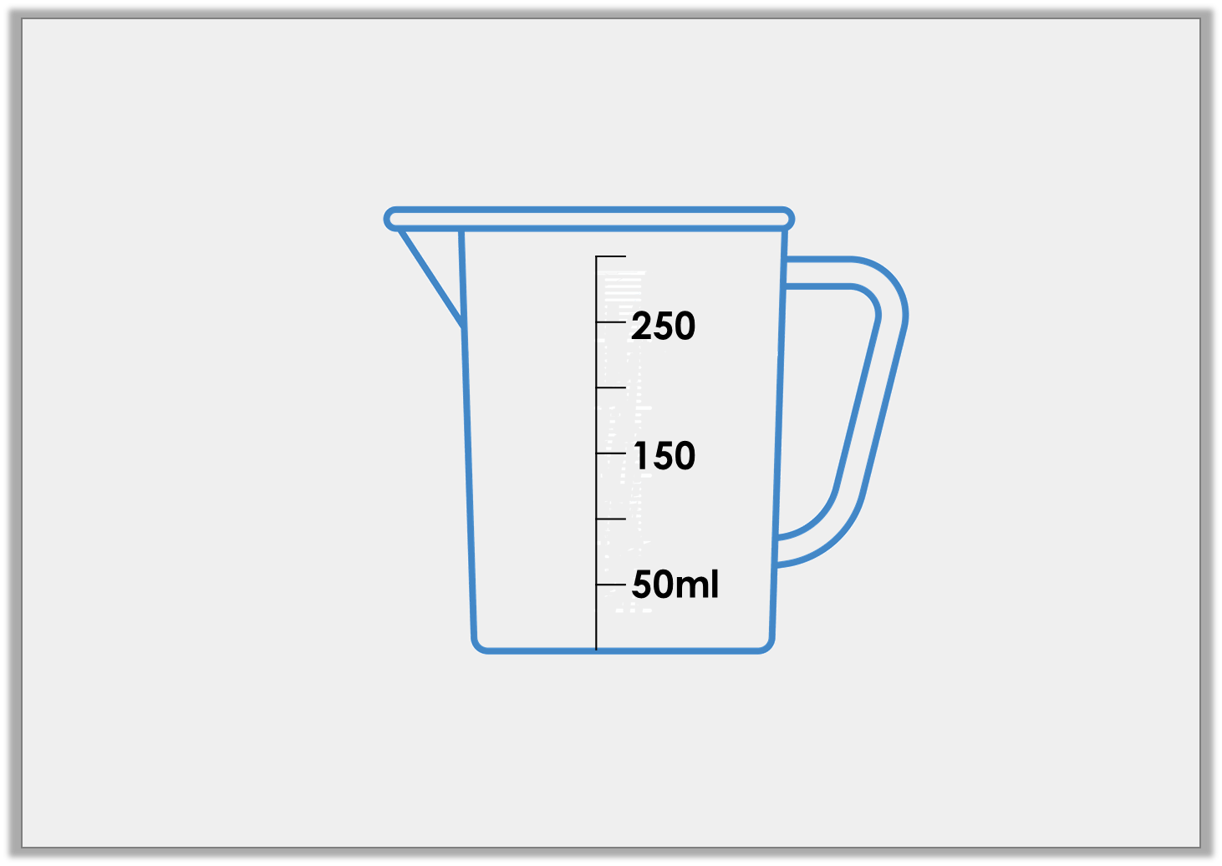
Problem Solving 1
Tom has poured water into the measuring jug below.
The volume is more 50ml than but less than 300ml.
How much water could he have?
Use arrows to label 3 possible answers.
Y3
© Classroom Secrets Limited 2018

Slide 5
Problem Solving 1
Tom has poured water into the measuring jug below.
The volume is more 50ml than but less than 300ml.
How much water could he have?
Use arrows to label 3 possible answers.
250ml
200ml
100ml
Y3
© Classroom Secrets Limited 2018

Slide 6
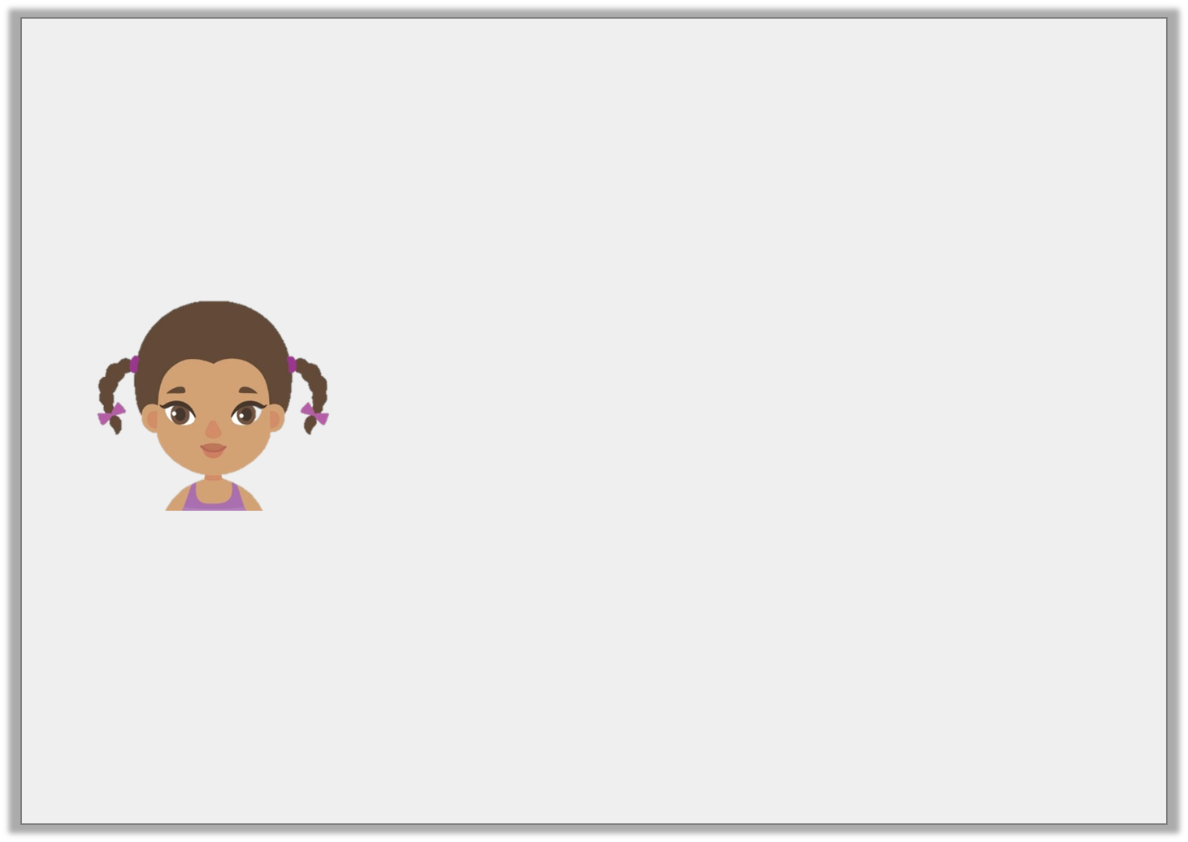
Reasoning 2
Is Aisha correct? Explain your answer.
I have 200ml of liquid in my container.
250
150
50ml
Y3
© Classroom Secrets Limited 2018

Slide 7
Reasoning 2
Is Aisha correct? Explain your answer.
Alisha is correct because. . .
I have 200ml of liquid in my container.
250
150
50ml
Y3
© Classroom Secrets Limited 2018

Slide 8
Reasoning 2
Is Aisha correct? Explain your answer.
Alisha is correct because the scale is in increments of 50ml. The water level is between 150ml and 250ml so the volume of the liquid is 200ml.
I have 200ml of liquid in my container.
250
150
50ml
Y3
© Classroom Secrets Limited 2018

